Slide 1
Coordinated Entry: A Pathway to Assistance

Slide 2
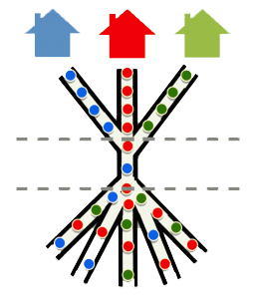
What is Coordinated Entry?
It is a system to coordinate housing referrals for those experiencing literal homelessness.

Slide 4
Coordinated Entry is an integrated process that streamlines access to limited resources in a community using assessment, case conferencing and client choice to match the needs of clients experiencing homelessness with available resources in a consistent and transparent manner. The CE system in the Lowcountry is intended to facilitate immediate and long-term housing interventions for those individuals or families that meet the HUD category 1 or category 4 definition of homelessness.

Slide 5
How does this work in our CoC?

Slide 6
Communication
Director
Manager
Housing Crisis Line Team
Outreach Team
Other Partners

Slide 7
The Housing Crisis Line operates 7 days per week. Calls are answered by 211 operators then those who are sleeping outside are transferred to our team for further assistance and available referrals.
843-737-8357
This number is available to the 7 counites we serve in the Lowcountry: Charleston, Berkeley, Dorchester, Hampton, Jasper, Colleton and Beaufort
Referrals can be made only when programs have openings

Slide 8
Outreach Coordinators are also in the community meeting with people in encampments and other areas throughout the Lowcountry.

Slide 9
To refer a client to Coordinated Entry using HMIS:
Before making the referral to CE, please be sure to complete the following in HMIS:
Client profile is complete
Client must be literally homeless (streets ,shelter or place not meant for human habitation)
CES assessment on profile page is complete
Completed Vulnerability Assessment
Note in Client Notes that details the situation and why a referral is being made
Make referral to CoC
It is the responsibility of the referring case manager to maintain contact, update HMIS notes and continue efforts to divert
the client to other housing solutions. Any incomplete referrals cannot be accepted
To refer a client to Coordinated Entry not using HMIS:
Have the client call the Housing Crisis Line (843-737-8357) or connect with outreach staff

Slide 10
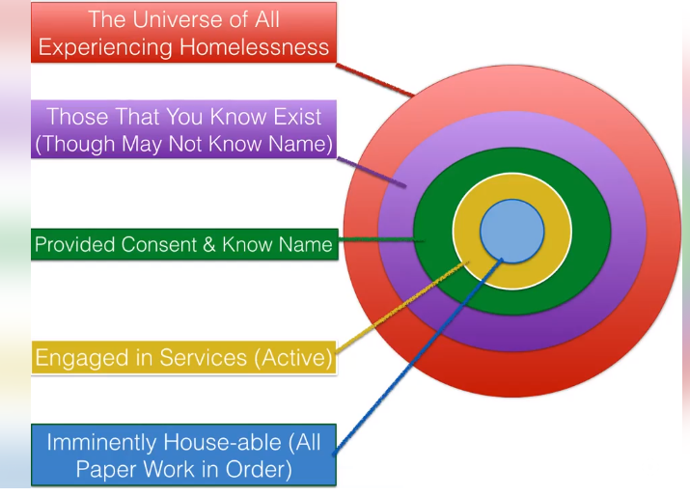

Slide 11
The following is reviewed by the CoC Manager before adding to CE:
HMIS entry is complete
Homeless Status
Enrolled in a project
Recent notes
Incomplete referrals cannot not be accepted

Slide 12
What if I don’t have HMIS access?
Case conferencing/Housing Solutions meetings are not just for HMIS agencies but are for those who accept housing referrals from Coordinated Entry. HMIS is not only for HUD funded programs. We are open to discussing HMIS use with agencies who assist with long term housing option or are directly working with those who are experiencing homelessness to locate housing.

Slide 13
Every other week, the pool is reviewed at the Housing Solutions Meeting
Each week, referrals to CE are sorted based on specific criteria set by HUD and the Coordinated Entry Committee
CE is a process. Adding someone does not guarantee a referral
Those who have added people to the referral pool are encouraged to attend to discuss clients and referrals

Slide 14
At the meeting, clients are discussed. Programs let us know if they have Rapid ReHousing or Permanent Supportive Housing openings. Clients case conferencing is conducted. Please advise your client not to wait for a referral through CE and continue to assist your client to access other housing options and updates notes in HMIS. If someone finds a place to stay before they are referred to housing assistance through CE, please make sure to follow-up with the CoC Program Manager immediately so they can update the client status for Coordinated Entry.

Slide 15
I'm working with a client who was added Coordinated Entry and they have not received a referral, what happened?

Slide 16
The CE process prioritizes assistance based on factors related to vulnerability and severity of service needs. It does not work like a waiting list. There is no guarantee of referral, no static order of placement and we cannot predict upcoming vacancies or potential matches for those vacancies.

Slide 17
What can I do to help the clients I am working with?

Slide 18
Review the homeless history in HMIS for accuracy and make updates
Report changes if you don't have HMIS access
Identify other solutions such as deposit only assistance and diversion
Keep in contact with the client

Slide 19
If you are working directly with a client to help house them, consider attending the
Housing Solutions Meeting

Slide 20
Please visit our website at www.lowcountrycoc.org or contact Heather Carver if you have any questions.

Slide 21
Resource Sharing
Notes:
Food
Phone
Shower
Clothing
Shelter
Employment

Slide 22
Point In Time Count

Slide 23
What the unsheltered PIT count is and what it isn’t
The Point-in-Time (PIT) count is a count of sheltered and unsheltered homeless persons on a single night in January.
A PIT count is intended to capture information on the homeless population to create a “snapshot” of what homelessness looks like in our community.
Doesn’t count everyone that has been homeless ever in a particular community
Doesn’t replace other data reports; It is a piece of the data puzzle
Doesn’t Work without volunteers and community support

Slide 24
Who?
What?
When?
Where?
Why?

Slide 25
Can we count on you? Sign up at: https://lowcountrycoc.org/count

